Slide 1
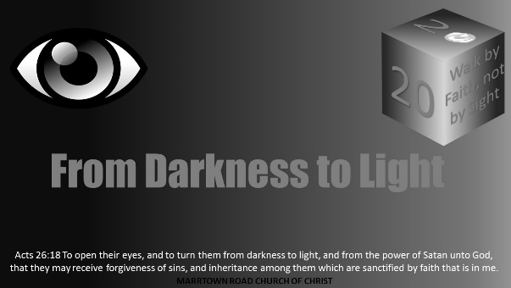


Slide 2
Darkness Lesson 1 Introduction: Join Us in 2020

Slide 3
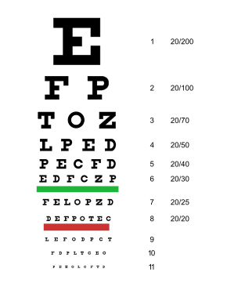
Introduction
Because of the 20/20 Snellen visual acuity chart, Americans associate 20/20 with good vision.
As a result, the year 2020 has sparked a desire to develop biblical material centered around “Enlightening the Eyes.”
In specific, this year-long study called “From Darkness to Light” is the title phrase from Acts 26:18.
The goal of this project is to help “children of the Light” see the eternal; things not seen with the eyes but seen by faith.

Slide 4
Introduction
God’s word teaches many spiritual concepts using the eyes.
Sometimes, it is the contrast of walking by faith and not by sight, the call of humanity from darkness to God’s marvelous light.
It is also the need to keep our eyes on Christ, lest like Peter we misfocus on the waves of the sea.
Other times, it is how Christians must look to the eternal rather than the temporal things Satan uses to blind us from the eternal promises.

Slide 5
Introduction
The study materials are for two classes with 25 lessons each.
The two-class halves are “From Darkness” and “To Light.”
In “From Darkness,” we start with a section on spiritual blindness followed by a section called “Eyes Full of Adultery,” The next section is the “Devil’s Dark Distortions” exploring many problems Satan uses to change our view. The last section is called “Lust of the Eyes,” and generally looks at covetousness in several forms.
In “To Light,” we start with a section called “God is Light.” We continue in a section called “Children of Light.” The next section is called “Seen and Unseen.” The last two sections are “Walking in the Light” and “Visual Perception.”

Slide 6

What is your favorite?
If we think about eyes, light, perception, vision, darkness, or light, many scriptures might come to mind.
By way of introduction, consider some of the more commonly known passages around this theme from God's word.

Slide 7
Light Versus Darkness
God's intent is to open our eyes to the Light and be holy by faith in Jesus.
1 John 1:5b instructs, “God is light, and in him is no darkness at all.”
God sent the Christ and Apostles such as Paul “to open their eyes, and to turn them from darkness to light, and from the power of Satan unto God, that they may receive forgiveness of sins, and inheritance among them which are sanctified by faith that is in me” (Acts 26:18).
God will enlighten the eyes to all He has done for the children of Light.
Ephesians 1:17-19 teaches, “That the God of our Lord Jesus Christ, the Father of glory, may give unto you the spirit of wisdom and revelation in the knowledge of him: The eyes of your understanding being enlightened; that ye may know what is the hope of his calling, and what the riches of the glory of his inheritance in the saints, And what is the exceeding greatness of his power to us-ward who believe, according to the working of his mighty power.”

Slide 8
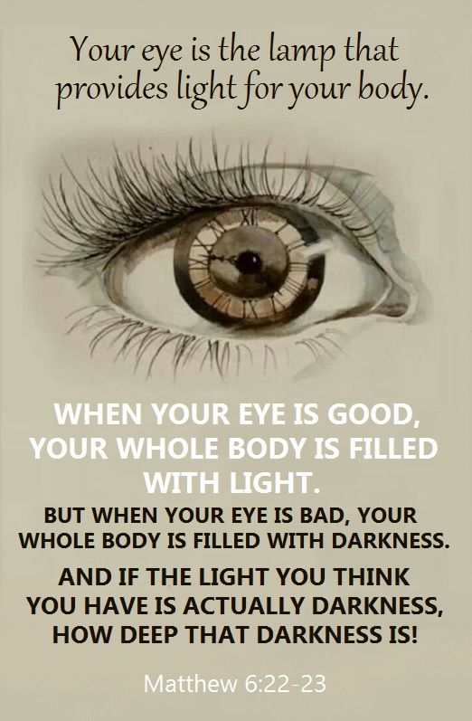
Understanding and Perception
The eye is a place of understanding and perception.
Matthew 6:22-23 teaches, “The light of the body is the eye: if therefore thine eye be single, thy whole body shall be full of light. But if thine eye be evil, thy whole body shall be full of darkness. If therefore the light that is in thee be darkness, how great is that darkness!”
Humans get to choose to seek God or to be enslaved by Satan.
This text is about being single or focused on God.

Slide 9
Darkness and Distortion
Satan, the father of lies, has many snares and distortions to darken human perception and cause spiritual blindness.
1 John 2:16-17 explains some of those tools Satan uses to detour, distort, and darken humanity's view. “For all that is in the world, the lust of the flesh, and the lust of the eyes, and the pride of life, is not of the Father, but is of the world. And the world passeth away, and the lust thereof: but he that doeth the will of God abideth for ever.”
These darkening distortions may come in many alluring forms but should be guarded against.

Slide 10
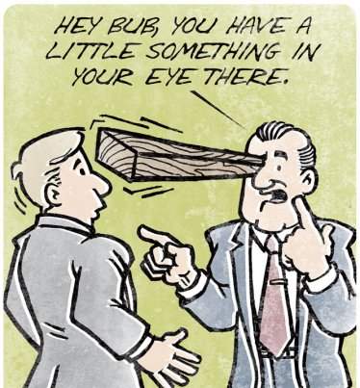
Darkness and Distortion: Hypocrisy
One such darkening distortion of the devil is hypocrisy. Rather than focusing on growing ourself spiritually, we can be improperly concerned for our brother in hypocrisy. Matthew 7:3 illustrates, “And why beholdest thou the mote that is in thy brother's eye, but considerest not the beam that is in thine own eye?”

Slide 11
Darkness and Distortion
Satan's false teachers and lie spreaders have eyes full of adultery. 2 Peter 2:14 remarks, “Having eyes full of adultery, and that cannot cease from sin; beguiling unstable souls: a heart they have exercised with covetous practices; cursed children.”
Another example pervasive in American culture would include the lust of the eyes and the flesh such as the sins of pornography and fornication. Habakkuk 1:13 refers to God's purer eyes or holiness which Christians are called to when he remarks, “Thou art of purer eyes than to behold evil, and canst not look on iniquity: wherefore lookest thou upon them that deal treacherously, and holdest thy tongue when the wicked devoureth the man that is more righteous than he?”
In a culture like the one described by Romans 1, sections of our culture have darkened, becoming foolish in their profession of their wisdom. The minds of that cultural section becoming reprobate, often moved beyond feeling in their iniquity.

Slide 12
Eyewitness and Identifying the Christ
The eyewitnesses of the Bible record the teachings and miracles of Jesus. John expressed in 1 John 1:1, “That which was from the beginning, which we have heard, which we have seen with our eyes, which we have looked upon, and our hands have handled, of the Word of life.”
Many today are like the Jews in John 9 who tried to persuade others that Jesus was a sinner even when He performed the miracle of restoring the man's sight while the Jews remained blind in their sin. John 9:30-33 reads, “The man answered and said unto them, Why herein is a marvellous thing, that ye know not from whence he is, and yet he hath opened mine eyes. Now we know that God heareth not sinners: but if any man be a worshipper of God, and doeth his will, him he heareth. Since the world began was it not heard that any man opened the eyes of one that was born blind. If this man were not of God, he could do nothing.”

Slide 13
Eyewitness and Identifying the Christ
Jesus was declared as the Messiah in His healing of the blind as Isaiah had foretold.
This healing of the blind was part of what Jesus told John's disciples to observe and report back to John. Matthew 20:33-34 illustrates, “They say unto him, Lord, that our eyes may be opened. So Jesus had compassion on them, and touched their eyes: and immediately their eyes received sight, and they followed him.”
There is no doubt Jesus was identified by His miracles and by many eyewitnesses.
He healed the blind then and still is healing the spiritually blind now.

Slide 14
Eyewitness and Identifying the Christ
Satan, with his lies and distortions, has sought to keep folks blind and enslaved to sin.
God wants his children to escape the corruption in the world through lust and become partakers of the divine nature and His holiness.
Many times, there is a failure to see what has been told.
Jesus remarked in Mark 8:18, “Having eyes, see ye not? and having ears, hear ye not? and do ye not remember?”
Spiritual blindness is still a problem today. The senses are often blinded and dulled by Satan.

Slide 15
Eyewitness and Identifying the Christ
Now, we have a chance to see and hear Jesus and be blessed. Matthew 13:15-16 reads, “For this people's heart is waxed gross, and their ears are dull of hearing, and their eyes they have closed; lest at any time they should see with their eyes, and hear with their ears, and should understand with their heart, and should be converted, and I should heal them. But blessed are your eyes, for they see: and your ears, for they hear.”

Slide 16

Eyewitness and Identifying the Christ
Today, we must look through an eternal prism rather than through the distortive lens of sin. This requires us to see with faith rather than our eyes.
Hebrews 11:1 teaches, “Now faith is the substance of things hoped for, the evidence of things not seen.”

Slide 17

Eye Plucking
Jesus even instructs plucking out one's eye is better than going to hell.
Matthew 5:29 reads, “And if thy right eye offend thee, pluck it out, and cast it from thee: for it is profitable for thee that one of thy members should perish, and not that thy whole body should be cast into hell.”
This teaching is much harder for most people than the "eye for eye" of Exodus 21:24.

Slide 18

Focusing on The Spiritual and Eternal: Walking In The Light
We must focus our eyes on Jesus as the author and finisher of the faith.
Hebrews 12:2 instructs, “Looking unto Jesus the author and finisher of our faith; who for the joy that was set before him endured the cross, despising the shame, and is set down at the right hand of the throne of God.”
We cannot take our eyes off Jesus to look at the storms of life as Peter did.
Jesus has told His followers to walk in the light of faith and holiness.

Slide 19
Focusing on The Spiritual and Eternal: Walking In The Light
The scriptures instruct Christians on how to grow and avoid blindness, so they walk as children of light.
2 Peter 1:9 details virtues of adding to one’s faith then remarks, “But he that lacketh these things is blind, and cannot see afar off, and hath forgotten that he was purged from his old sins.”
One can forget and be blinded by sin.

Slide 20

Focusing on The Spiritual and Eternal: Walking In The Light
Christians must learn to view the eternal rather than the temporal by walking as children of the light.
2 Corinthians 4:18 encourages, “While we look not at the things which are seen, but at the things which are not seen: for the things which are seen are temporal; but the things which are not seen are eternal.”

Slide 21
Focusing on The Spiritual and Eternal: Walking In The Light
Christians are called to walk in the light and grow as image bearers of God in reflecting His light, His love, and His holiness.
God instructs the children of light to be transformed in His service.
Humans are so visual in practice that Paul reminds the child of God, “For we walk by faith, not by sight” in 2 Corinthians 5:7.
This requires diligence on the Christian's part.
The servant of God is looking to eternity and that day of the last trump. “In a moment, in the twinkling of an eye, at the last trump: for the trumpet shall sound, and the dead shall be raised incorruptible, and we shall be changed."” (1 Cor 15:52).

Slide 22

In the year of the eye, in 2020, what can Christians do to battle Satan's darkness and enlighten their eyes of understanding to the hope of Christ's calling?

